Slide 1
CONTROL UNIT

Slide 2
CONTROL UNIT
A microoperation is an elementary operation performed with the data stored in registers.
  Register transfer microoperations
  Arithmetic microoperations
  Logic microoperations
  Shift microoperations
CU’s function is to initiate sequences of microoperations.

Slide 3
KEY POINTS
Instruction execution consists of fetch-decode-execute cycle.
Each phase is made up of a sequence of fundamental operations called micro-operations.
Micro-op can be
  Transfer between registers
  Transfer between register and bus
  An ALU operation

Slide 4
REGISTER TRANSFER MICROOPERATIONS
Information transferred from one register to another,denoted by R1←R2
If P=1 then R1←R2 represented as
P : R1←R2, P is called the control function which is a Boolean variable that is equal to 0 or 1.
Control Circuit
R1
Clock
P Load
n
R2

Slide 5
BUS AND MEMORY TRANSFER
Too many interconnections if separate lines used between each register.
A common bus system is more efficient.
Bus can be constructed using multiplexers and three-state buffers.

Slide 6
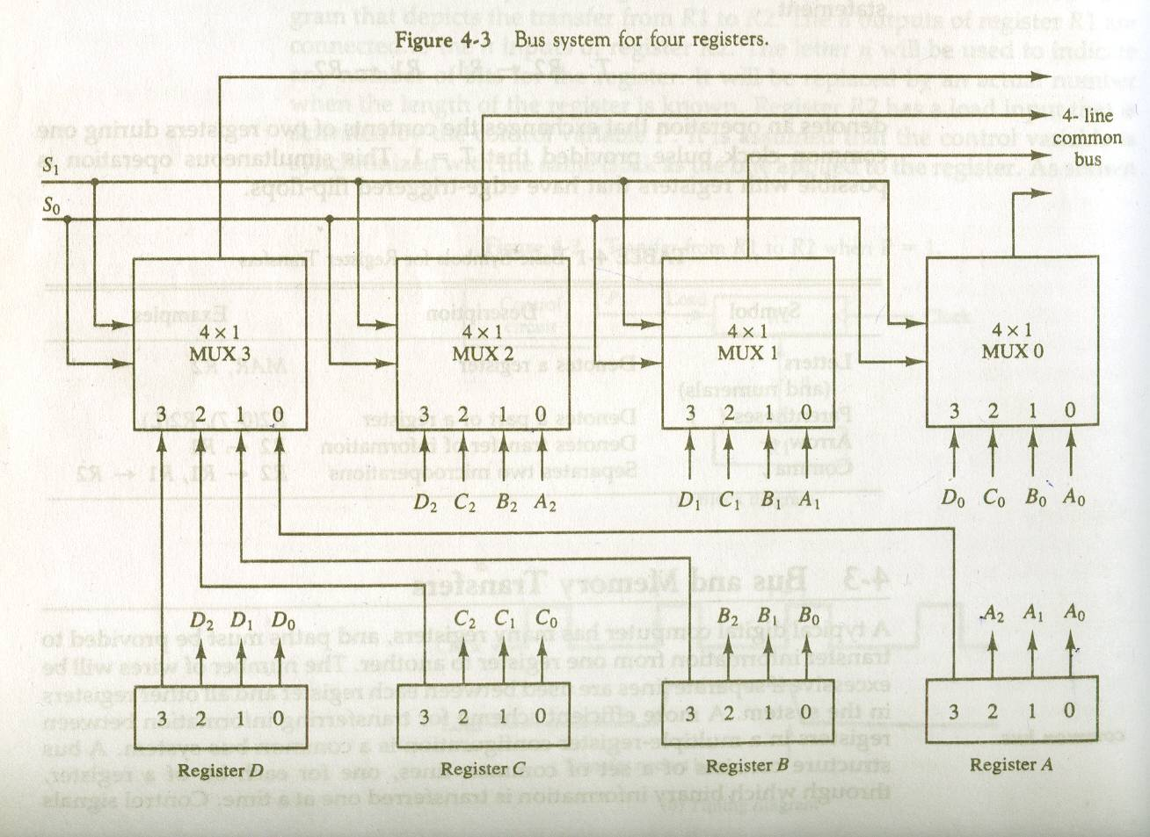
BUS SYSTEM USING MULTIPLEXERS

Slide 7
THREE STATE BUS BUFFER
Constructed using three-state gates
Three states- 0,1,high impedance (output is disconnected, no logical significance)
Output Y=A if C=1
Normal Input A
High impedance if C=0
Control Input C
Three State Buffer gate

Slide 8
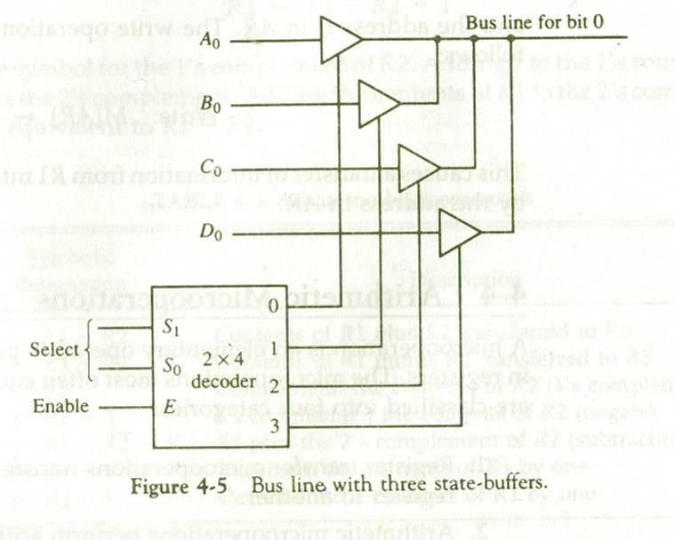
BUS LINE WITH THREE STATE BUFFER

Slide 9
MEMORY TRANSFER
Two forms of transfer- read and write
Memory word symbolized by M
Read : DR ← M[AR],
DR is the Data Register and AR is Address Register which contains the memory address of the word to be read.
Write : M[AR] ← DR

Slide 10
ARITHMETIC MICROOPERATIONS
Basic operations –
  Addition, Subtraction, Increment, Decrement, negate and Shift.
Division and Multiplication are not included as multiplication is implemented as a sequence of addition and shift microops and division is implemented as a sequence of subtraction and shift microops.

Slide 11
LOGIC MICROOPERATIONS (1)
Operations performed on strings of bits.
Basic operations – AND, OR, XOR, Complement
Applications –
  Selective set : sets to 1 the bits in register A where there are corresponding bits in register B. OR operation used.
    A 1010
    B 1100
    Result 1110
  Selective complement-complement bits in A where there are corresponding 1s in B. XOR is used.
    A 1010
    B 1100
    Result 0110

Slide 12
LOGIC MICROOPERATIONS (2)
  Selective clear : clear to 0 the bits in A where there are corresponding 1s in B. A ∧ B’
    A 1010
    B 1100
    Result 0010
  Mask : bits of A are cleared if there are corresponding 0s in B. AND is used.
    A 1010
    B 1100
    Result 1000
  Insert : inserts a new value into a group of values. First mask unwanted bits and then AND with new bits.
    A 01101010
    Mask 00001111
    After mask 00001111
    B 10010000
    Result 10011010

Slide 13
SHIFT MICROOPERATIONS
Used for serial transfer of data.
Used with arithmetic, logic operations.
Types of shift operations
  Logical shift : transfers 0 through the serial input. Two forms- shift left and shift right
  Circular shift : circulates the bits in the register without any loss of information. Two forms- circular shift left and circular shift right.
  Arithmetic shift: shifts a signed binary number to the left (multiply by 2) or right (divide by 2). Leaves the sign bit unchanged.

Slide 14
TASKS OF CONTROL UNIT
Causes processor to execute micro-ops in the proper sequence, determined by the instruction.
Generates the control signals that cause each micro-op to be executed.
Control signals cause the opening and closing of logic gates, resulting in execution of the micro-op.

Slide 15
IMPLEMENTATION OF CONTROL UNIT
Hardwired implementation
Microprogrammed implementation

Slide 16
HARDWIRED IMPLEMENTATION
Control Unit is a combinatorial circuit.
control signals are generated by hardware using conventional logic design techniques.
Its input signals are transformed into a set of output logic signals which are the control signals.

Slide 17
CONTROL UNIT
INSTRUCTION REGISTER
DECODER
Io
I1
In
TIMING
GENERATOR
T1
CONTROL UNIT
Clock
Flags
T2
Tn
Co
C1
Cn

Slide 18
CONTROL UNIT LOGIC
For each control signal, a Boolean expression is derived as a function of the inputs.

Slide 19
MICRO-PROGRAMMED CONTROL
Use sequences of instructions to control complex operations
Called micro-programming
A control unit whose binary control variable is stored in memory is called Microprogrammed Control Unit.

Slide 20
IMPLEMENTATION(1)
The control unit generates a set of control signals for each micro-operation. Each control signal represented by 0 or 1.
The control signals at any given point of time is a string of 0’s and 1’s and is called a control word.
Have a sequence of control words for each machine code instruction
Each step is called microinstruction and complete set of steps required to process a machine instruction is called the microprogram.

Slide 21
IMPLEMENTATION(2)
The microprogram for each machine instruction is placed in ROM.
Dynamic microprogramming allows a microprogram to be loaded from auxiliary memeory.

Slide 22
CONTROL MEMORY
Computers using MCU consists of two memories-
  Main memory – for storing user programs
  Control Memory – for holding microprograms
Each machine instruction initiates a series of microinstructions in control memory.
The microinstructions generates the microoperations to
  Fetch the instruction from main memory
  Evaluate the effective address
  Execute the operation
  Return control to the fetch phase to repeat the cycle for the next instruction

Slide 23
MICROPROGRAMMED CONTROL ORGANIZATION(1)
Control Memory
  All control information stored permanently.
Control Address Register
  Address of microinstruction.
Control Data Register/Pipeline Register
  Microinstruction read from memory.

Slide 24
MICROPROGRAMMED CONTROL ORGANIZATION(2)
Next address of microinstruction can be
  Next in sequence
  Located elsewhere in control memory
Certain bits of the current microinstruction are used to determine the next address.
Next address can also be a function of external inputs.

Slide 25
MICROPROGRAMMED CONTROL ORGANIZATION(3)
Sequencer/Next Address Generator
  Generates next address while current µ-instruction is executing
  Typical functions
    Increment the control address register by one.
    Loading into CAR for an address from control memory.
    Transferring an external address
    Loading an initial address to start the control operation.

Slide 26
MICROPROGRAMMED CONTROL ORGANIZATION
Control
Unit
Next Address
Generator
Control
Address
Register
Control
memory
Control
Data
Register
External input
Next address information

Slide 27
ADDRESS SEQUENCING
Steps in executing a single computer instruction
  Initial address (address of first micro-instruction that activates instruction fetch routine) is loaded in CAR.
  May be sequenced by incrementing the CAR.
  End of fetch routine, instruction is in the IR.

Slide 28
CONTD..
  Next, effective address generation routine can be reached through a branch microinstruction conditioned on the mode field of the instruction.
  At the end of this routine, operand address is in the MAR.
  Next, routine to execute instruction
    depends on the operation code of the instruction.
  Transformation of the opcode field of an instruction to an address in control memory where the routine is located is called mapping.

Slide 29
CONTD..
  Once routine is reached, microinstructions may be sequenced by incrementing the CAR or based on values of certain processor bits.
  Microprograms that uses subroutines require an external register to store return address.
  When execution of instruction is completed, control returns to the fetch routine
    Implemented by executing an unconditional branch to the first address of the fetch routine.

Slide 30
SELECTION OF ADDRESS FOR CONTROL MEMORY
Instruction Register
Mapping
Logic
Subroutine Register
status bit
Branch Logic
MUX Select
Multiplexer
Incrementer
Clock
Control Address Register
Control Memory
Select a status bit
Branch address
Microoperation

Slide 31
MAPPING OF INSTRUCTIONS
Operation code consists of 4 bits i.e 16 operations.
Control memory has 128 words, i.e 7 bit address.
For each operation, there exists a micro routine in control memory.
Conversion from 4-bit opcode to 7-bit micro-routine address.

Slide 32
MAPPING OF INSTRUCTION CODE TO MICROINSTRUCTION ADDRESS
Computer Instruction
1 0 1 1
address
Mapping Bits
0 x x x x 0 0
Microinstruction address
0 1 0 1 1 0 0

